Slide 1

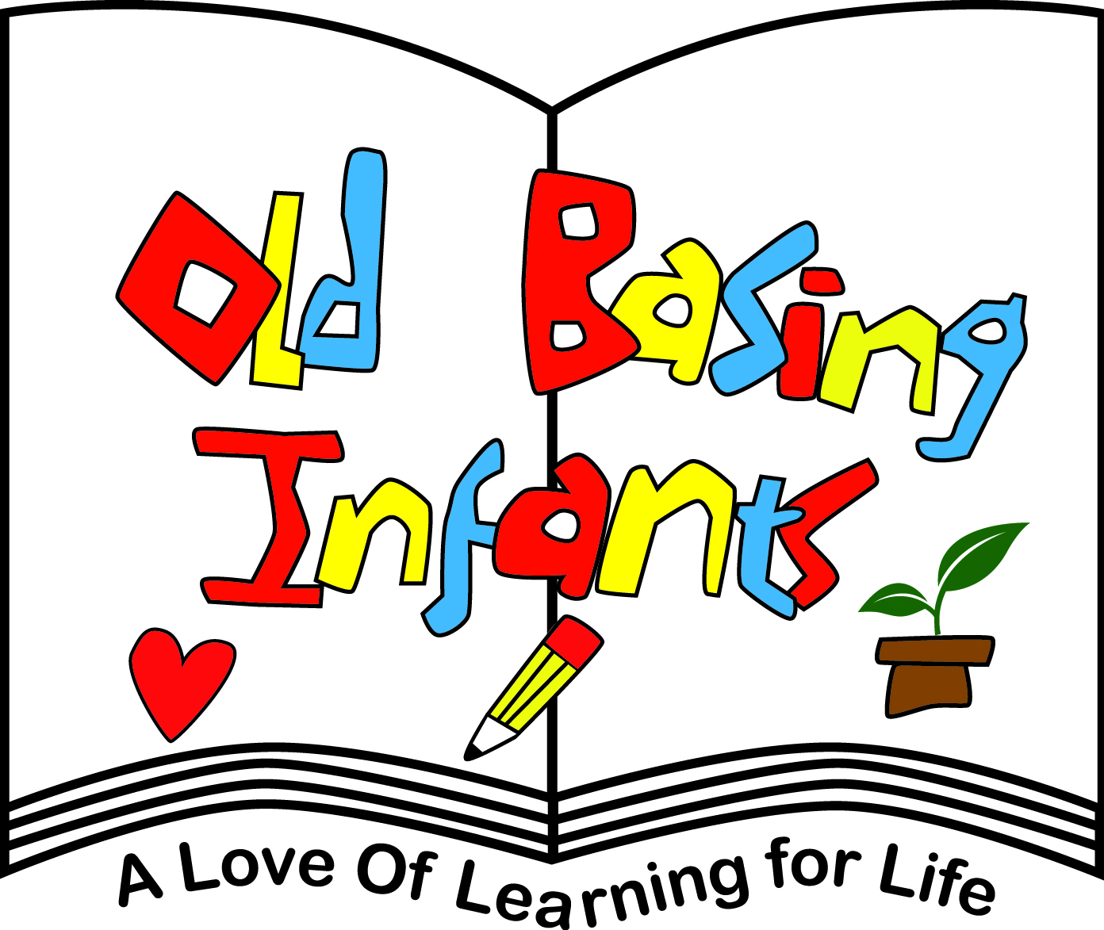

Parents Guide to

Slide 2
At Old Basing Infant School we recognise and value the importance of promoting positive mental health
and emotional well being. By introducing our Year 2 children to the Zones of Regulation programme we aim to teach the children how to identify emotions in themselves and others and provide them with a bank of strategies to help regulate their emotions and improve their well being.
Zones of Regulation supports children to develop their skills in the area of self - regulation

Slide 3
Self-regulation can go by many names such as ‘self-control’, ‘impulse management’ and ‘self-management’. Self-regulation is best described as the best state of alertness for a situation. For example, when your child takes part in a sports game, they would need to have a higher state of alertness than when, for example, they were working in a library.
From time to time, all of us (including adults) find it hard to manage strong feelings such as worry, anger, restlessness, fear or tiredness, and this stops us from getting on with our day effectively. Children who feel these emotions often find it hard to learn and concentrate in school. The Zones of Regulation aims to teach children strategies to help them cope with these feelings so they can get back to feeling calm and ready to learn. These coping strategies are called ‘self-regulation’.

Slide 4
We want to teach our children good coping and regulation strategies so they can help themselves when they experience anxiety and stress. In the classroom, sometimes children panic when faced with a tricky learning problem or challenge. Teaching them how to cope with these feelings might make them better at tackling learning challenges and build better resilience so they don’t give up so easily when faced with difficulty.
We want children at Old Basing Infant School to grow into successful teenagers then adults. Teaching the children at a young age about managing their feelings will support them in later life so that they don’t turn to negative coping strategies which affect their mental and physical wellbeing.

Slide 5
We aim to help children to:
• Recognise when they are in the different Zones and learn how to change or stay in the Zone they are in.
• Increase their emotional vocabulary so they can explain how they are feeling.
• Recognise when other people are in different Zones, thus developing better empathy.
• Develop an insight into what might make them move into the different Zones.
• Understand that emotions, sensory experiences such as lack of sleep or hunger and their environment might influence which Zone they are in.
• Develop problem-solving skills and resilience
• Identify a range of calming and alerting strategies that support them (known as their personal ‘toolkit’)

Slide 6
What are the different zones?

Slide 7
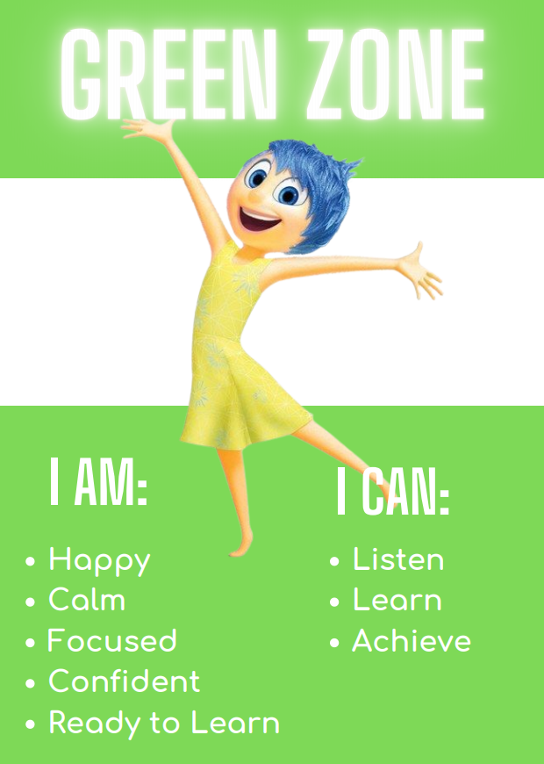
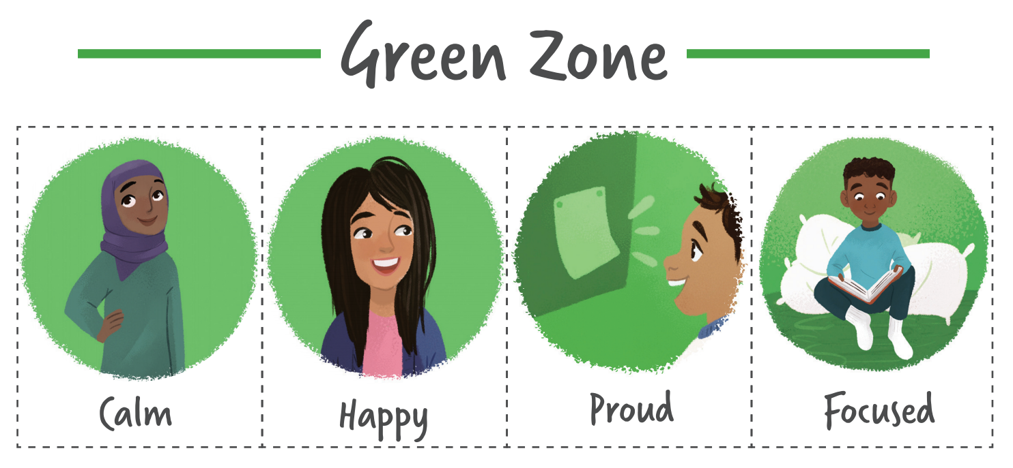

The Green Zone, like a green light, is when you are “good to go.” If you are in the Green Zone, you may feel happy, calm, and focused.

Slide 8
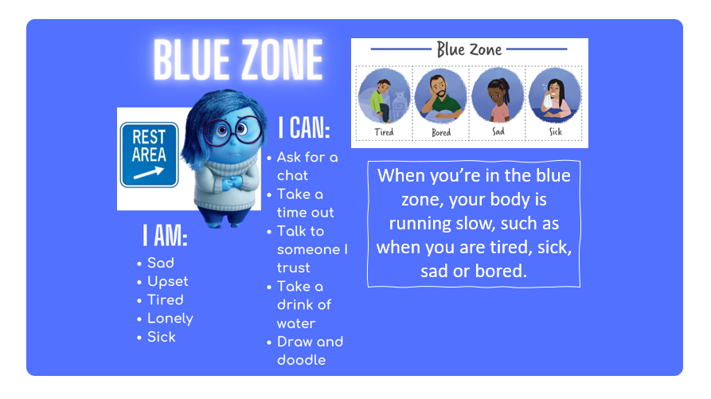

Slide 9
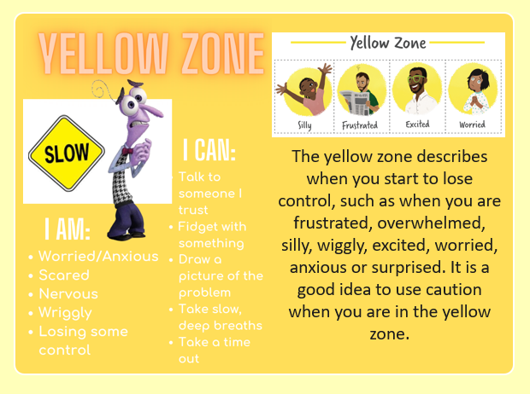

Slide 10
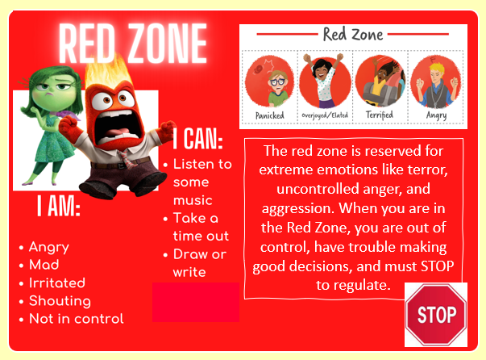

Slide 11
How have we taught the children about the Zones of Regulation?
We have introduced the Zones of Regulation through our PSHE curriculum. We will also be using the Zones language as part of daily school life so staff will be referring to them whilst talking to the children.
Some children might prefer not to use the ‘Zones language’ but label the emotions directly – this is fine and encouraged!
We have taught the children that everyone experiences all of the Zones. The Red and Yellow zones are not ‘bad’ or ‘naughty’ Zones. All of the Zones are expected at one time or another. For example, we have discussed with the children that the Blue Zone is helpful when you are trying to fall asleep and that it is likely that you would see some people in the Yellow Zone when they are with their friends at a fun birthday party.
Zones of Regulation is not used as a behaviour management strategy. We will not tell the children what zone they are in or should be in – the aim is for the children to recognise this themselves and understand which zone is best for them in different situations. For example, we would not say to the children “Stop doing that please that is yellow zone behaviour” or “You will need to miss some of your Friday Fun because you are in the red zone”. Some examples of things we might say are, “What zone are you in at the moment? Which zone do you learn best in? How could you get back to that zone?”. We also do not make the children display what zone they are in for everybody else to see. It is the child’s choice if they would like to tell someone.

Slide 12
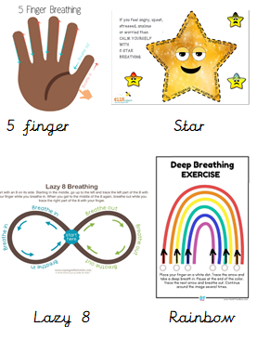
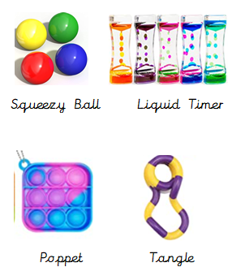
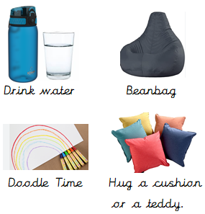
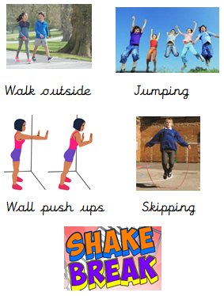
What does Zones of Regulation look like on our classrooms?
The children have had the opportunity to try out different ‘tools’ to decide what helps them when they are in each zone.
Each child created a ‘toolkit’ deciding what they will use if they need to in each zone. Below are some of the ‘tools’ that the children tried and then decided what they would use to help them in each zone if they need to. They spent time deciding which tools kept them alert and which tools calmed them down. These tools are all available to the children at school. We also have posters on display in each class to remind us of the different zones.

Slide 13
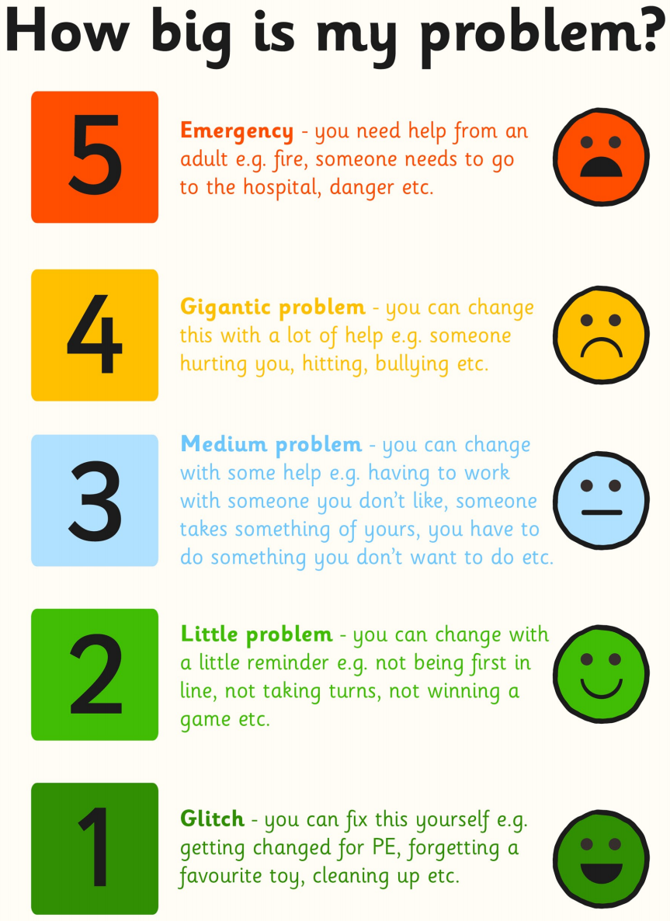
Whilst learning about the different
Zones and understanding how
different problems can put us in
different zones, we have also taught the children to consider the size of their problem in contrast
to the size of their reaction. All problems cause emotions but it is important to be able to regulate our emotions and respond appropriately. For example, dropping your fork on the floor at lunchtime wouldn’t need the same reaction as if you had broken your arm.

Slide 14
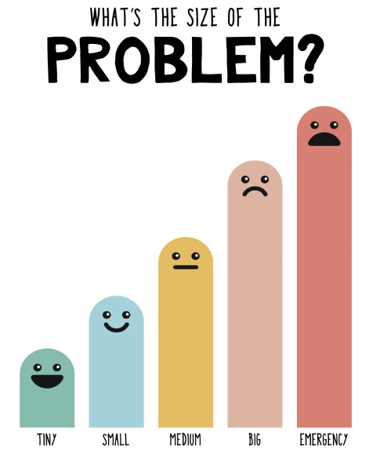
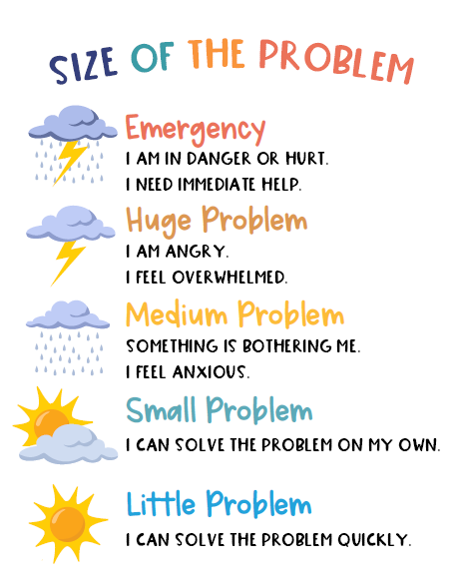
Your children will be bringing home these visuals to remind them of this.

Slide 15
How can you help your child use The Zones of Regulation at home?
• Identify your own feelings using Zones language in front of your child (e.g. I’m frustrated. I think I am in the Yellow Zone.”)
• Talk about what tool you will use to be in the appropriate Zone (e.g.“I need to take four deep breaths to help get me to be in the Green Zone.”)
• At times, wonder which Zone your child is in. Or, discuss which Zone a character in a film / book might be in. (e.g.“You look sleepy. Are you in the Blue Zone?”)
• Engaging your child in discussion around Zones when they are in the Red Zone is unlikely to be effective. You need to be discussing the different Zones and tools they can use when they are more regulated / calm.
• Remind your child which tools they can use. (eg: “It’s time for bed. Let’s read a book together in the comfy chair to get you in the Blue Zone.”)
• Model to your child how you use tools to get into a zone. You might say “I am going to make myself a cup of tea and do some breathing exercises because I am in the blue zone but I want to be in the green zone”.
• Praise and encourage your child when they share which Zone they are in.
Your child will be bringing home a copy of their toolkit – take the time to look at this with your child and let them tell you about the tools they decided worked best for them. You may want to make these tools available to them at home too or create a separate toolkit for using at home. The children will also bring home a copy of some of the breathing techniques they have been introduced to.

Slide 16
Common questions about the Zones of Regulation.
Can my child be in more than one zone at the same time?
Yes. For example, your child may feel tired (blue zone) because they did not get enough sleep, and anxious (yellow zone) because they are worried about an activity at school.
Can you look like one Zone on the outside and feel like you are in another Zone on the inside?
Yes. Many of us “disguise” our Zone to match social expectations. We use the expression “put on a happy face” or mask the emotion so other people will have good thoughts about us. Parents sometimes say that their children “lose it” and go into the Red Zone as soon as they get home. This is because children are increasing their awareness of their peers and expectations. They make every effort to keep it together at school to stay in the Green Zone. Home is when they feel safe to let it all out. As a school we do our best to encourage children to be themselves and show how they are feeling whilst with us, however, for some children this will remain difficult for them to do.
Is the Zones of Regulation an approach that works for all children?
We have introduced the Zones of Regulation as a strategy that children can choose to use if they find it helpful, and so far, many children choose to, and have been able to use the strategy successfully at school. Some children may choose to not use, or talk about, the Zones at school and this is absolutely fine. Sometimes the approach needs to be slightly adapted for certain children. Your child’s class teacher will recognise if this is not an approach that is working for your child in school and will be able to support your child’s self-regulation skills in other ways.

Slide 17
Can the Zones of Regulation approach be used with Neurodivergent children?
This is dependent on the child and their needs. Many Neurodivergent children find the Zones of Regulation a successful strategy for communicating their emotions at school and finding out which tools help them with self- regulation. They may find that they need to use their ‘toolkit’ more often than their Neurotypical peers. Sometimes the approach may need to be adapted, e.g some Neurodivergent children find that they learn best when in the Yellow Zone as they do not feel alert enough in the Green zone. For some Neurodivergent children, the pressure of feeling like they ‘should’ be in the Green zone when they are at school causes them anxiety which would mean this is not an appropriate strategy for supporting their self – regulation needs. Your child’s class teacher will have considered if the Zones of Regulation is having a positive impact on your child, whether it has needed to be adapted or whether a different approach is needed.

