Slide 1


New Parents’ Briefing
May 2026
Notes:
SD

Slide 2
Welcome
Introductions
Presentation will be on the school website
New Year R 2026-2027 – Children’s Tab
- Updates
- Videos – Drop off and pick up / Visiting the office / Meet the staff – coming soon
Today is an opportunity to ask any questions
Notes:
SD

Slide 3






Courage to try, Power to change
Courage
Kindness
Resilience
Collaboration
Curiosity
Respect
Notes:
SD

Slide 4
Information Packs
All the info you need.
Uniform – order sooner rather than later as it is a busy time for the company.
Please complete and return all forms – when you come for Starting Together is a good time to do this.
Notes:
SD

Slide 5
Information Packs
Included:
Forms for completion on the right-hand side: please do all
Entry timetable
RRE booklet
Housekeeping
School Uniform
Lunch menu – Special dietary requirements
Term dates and INSET days
Breakfast and After School Care Clubs
School Milk
F.O.O.B.S.
Notes:
SD

Slide 6
Pleas for your support!
Parking!
Transition
Late Arrivals
Sickness
Free School Meals
    Free for every child in YR, 1, 2
Pupil Premium
Leave of Absence
Notes:
SD

Slide 7
Starting Dates
Ready to start class visits - Week beginning Wednesday 2nd September to Friday 4th September.
All part-time start from Monday 7th September to Wednesday 9th September.
Full time – From Thursday 10th September.
Part–time option available if required – Please contact Mrs Denning (Headteacher) or Mrs Sciberras (Early Years Leader) to discuss this.
Notes:
SD

Slide 8
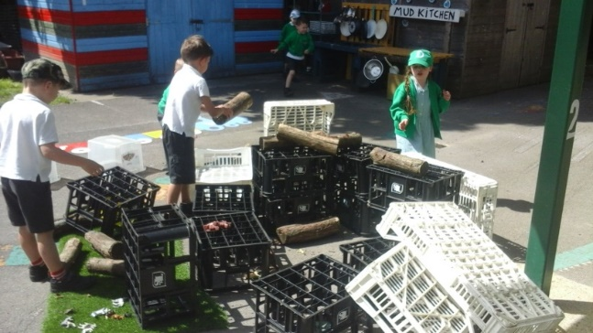
Our transition programme
Continuation of the education your child has received at pre-school – still working within the Foundation Stage. A curriculum evening in September will go into more detail on this.
Open door. Discussions in person or through the Home-School Communication Book.
Our partnership with you – we want this to begin right from your child’s first contact.
Notes:
CS

Slide 9

Our transition programme
Pre-school discussions and visits – June/July
Starting Together Sessions
Group A
Monday 22nd June: 9.15 - 10.15
Friday 10th July: 3.45 – 4.45
Group B
Friday 26th June – 3.45-4.45
Monday 6th July – 9.15 – 10.15
Notes:
CS

Slide 10
Our transition programme
Home Visits
Will take place in either July or September.
A quick 5-10 minute meet and greet of the children in their home to drop off a gift – No cups of tea, please!
Ready to Start
Beginning Wednesday 2nd September – Friday 4th September
Part-time attendance from Monday 7th to Wednesday 9th
September Curriculum Evening.
Follow up sessions from Barnardo’s during the Autumn Term.
The details of your Home Visit and Part-time attendance will be given to you in your last Starting Together session. If you know that you are unable to have a visit at the end of July (Between 13th and 22nd July) or start of September (Between 7th and 9th September), please inform the office so that we can accommodate your visit ASAP.

Slide 11
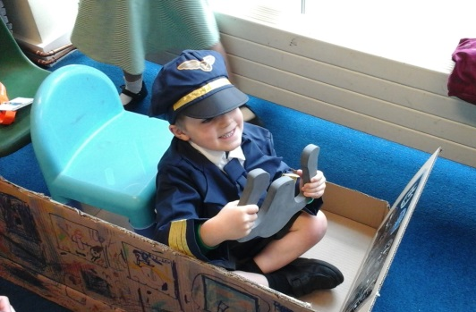
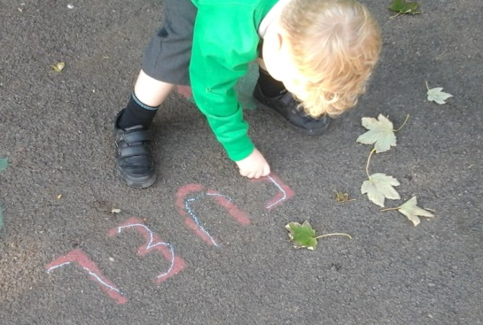
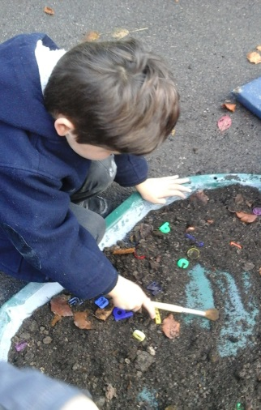
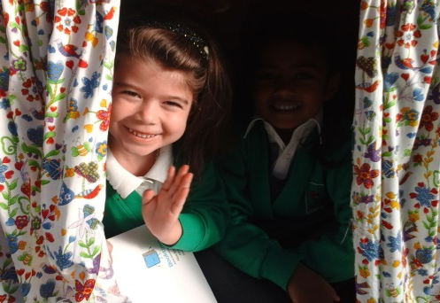
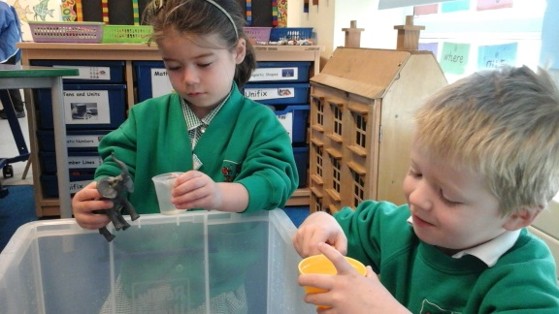
Before starting school…
What should I do before my child starts school?
‘Welcome to Year R’ Booklet
Hampshire Healthy Schools Website:
Pre-school | Health for Under 5s
and
Home - Starting Reception
Notes:
CS

Slide 12
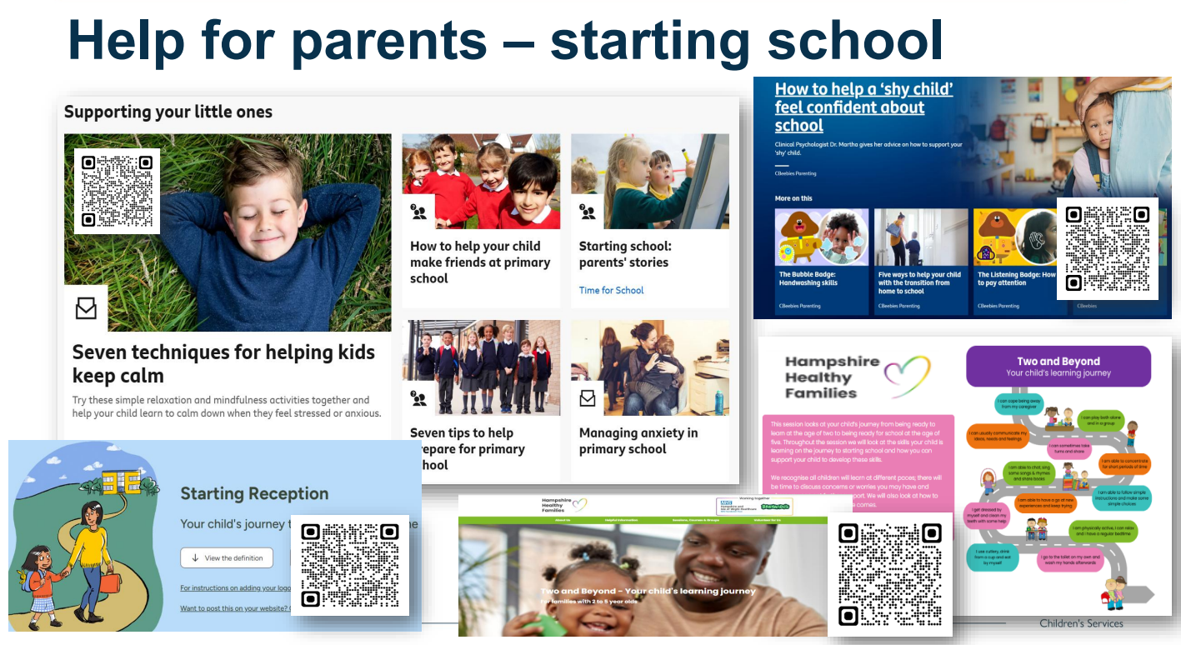
Services for Young Children

Slide 13


Expectations
Learning
Talk, talk, talk! Explaining, describing, commentary.
Surround them with a rich literary environment – Visit the library and model reading for pleasure.
Give children opportunities to explore and ask questions. Experience of back and forth conversations.
No expectation of being able to read, write or calculate.
Notes:
CS

Slide 14
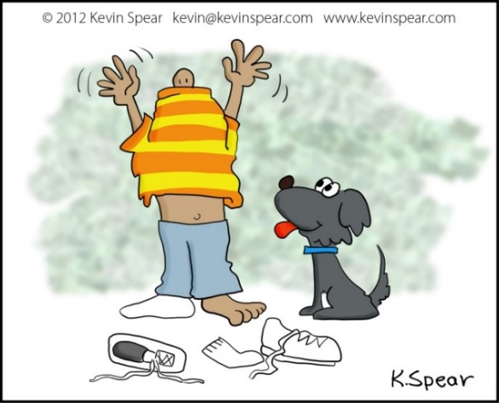
Expectations
Dressing:
Dress and undress independently.
Take off and put on their own jumper – remembering to ‘pull out’ the arms afterwards.
Do up their own coat.
Put on their own hat, scarf and gloves.
Encourage ‘trying’ before asking for help and praise this.
Notes:
CS

Slide 15
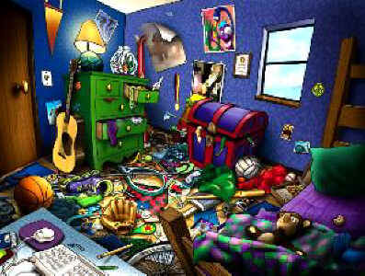
Expectations
Belongings
Put their own toys away.
Take responsibility for their own things.
Understanding that all toys and resources are shared and belong to the class.
Notes:
CS

Slide 16

Expectations
Eating
Have a go at using a knife and fork to cut and eat their food.
Open packs of food in their packed lunch boxes.
Eat a wide variety of foods.
Notes:
CS

Slide 17

Expectations
Toileting
Be toilet trained – clean and dry during the day.
Be able to wipe themselves after going to the toilet.
Be in the habit of flushing.
Be able to wash and dry their hands properly – 20 seconds rule.
Notes:
CS

Slide 18

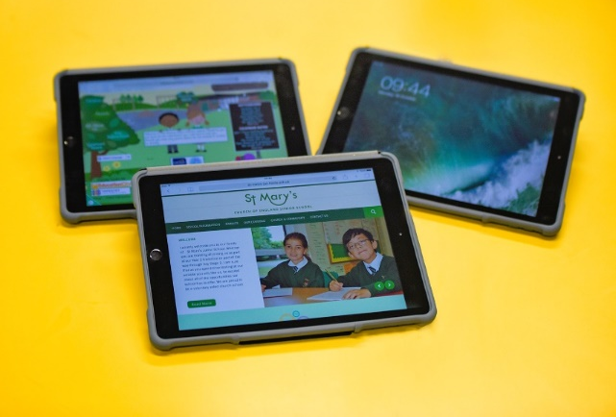
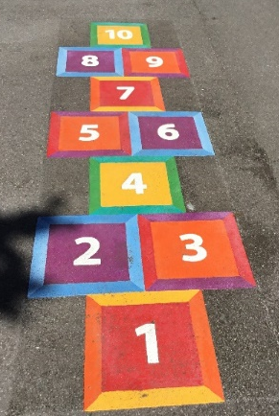
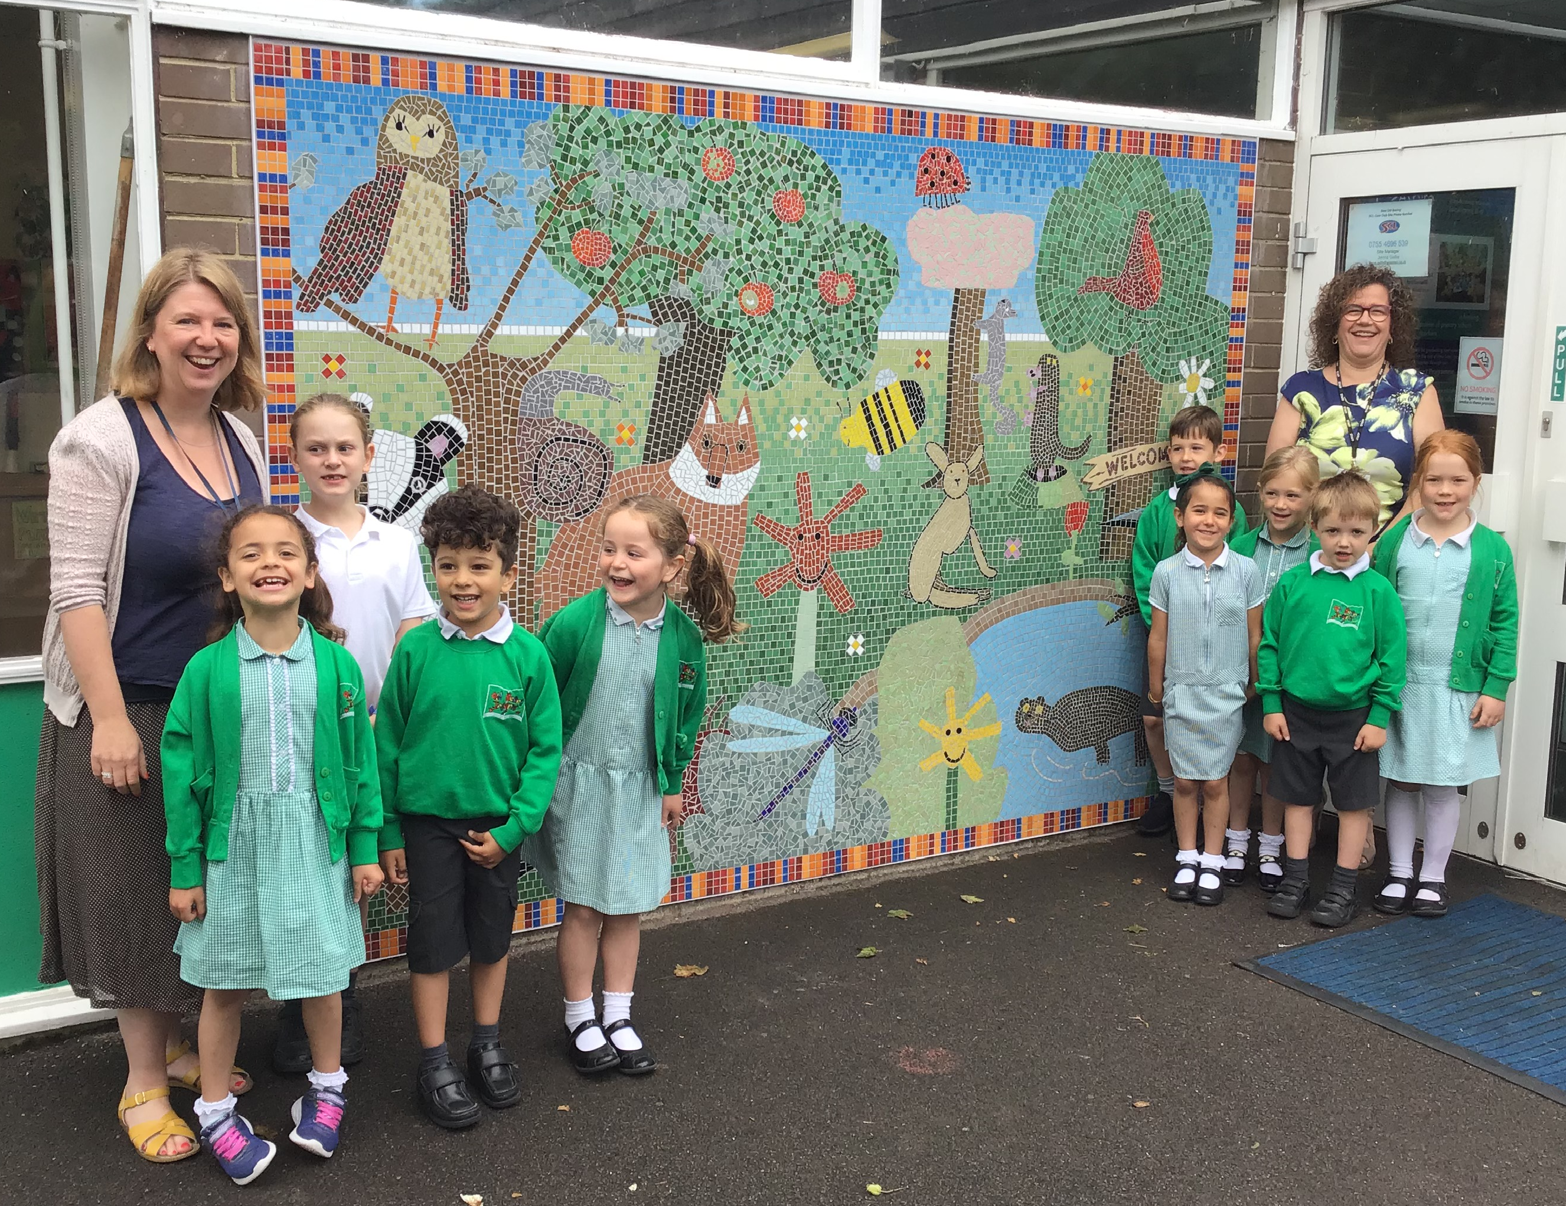
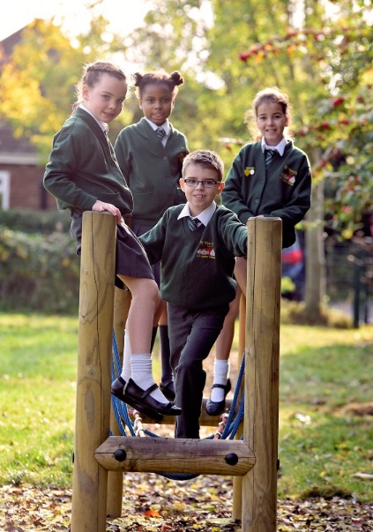
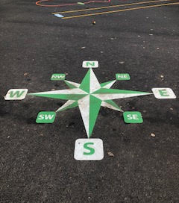
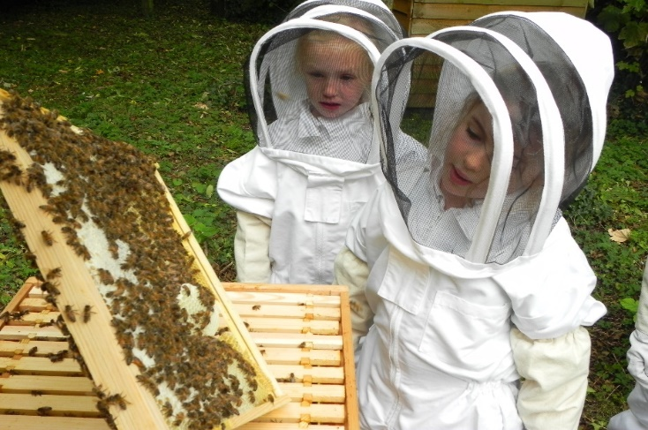
F.O.O.B.S.
New books
Software packages
Playground markings
Multi Use Games Area at the Infants
Sports Equipment
Notes:
SD

Slide 19

How do F.O.O.B.S. fundraise?
Discos
Christmas Markets
F.O.O.B.S. Lotto
Quiz Night
SUMMER FAIR
Treasure Hunt
2nd Hand Uniform
TRAIL & FUN RUN
Bags 2 School Recycling
Event Refreshments
Christmas Cards
Easter Fair
Letters to Santa kits
Notes:
SD

Slide 20
Any Questions?
Thank you for coming!
Have a look at our website for further information:
www.oldbasinginfants.co.uk

