Slide 1
A presentation to demonstrate how the sounds are introduced to the children during phonics sessions: c, k, e, r, h, m, d
Remember:
To use the pure sounds (e.g. M = mmmmm, not muh)
We use a multi-sensory approach when introducing each sound:
Saying the pure sound
Hearing it in words
Finding it in words
Looking at different representations of the letter (As both a capital and lower case letter) ‘My name is M and my sound is mmmm’
Jolly Phonics Songs can be found here: Jolly Songs Group 2 "c" "k" "e" "h" "r" "m" "d" with actions and letter formation - YouTube
And remember…no ‘schwa’ing! The little learners youtube video explains this really well and can be found here: https://www.youtube.com/watch?v=yVyry9jpVjI

Slide 2
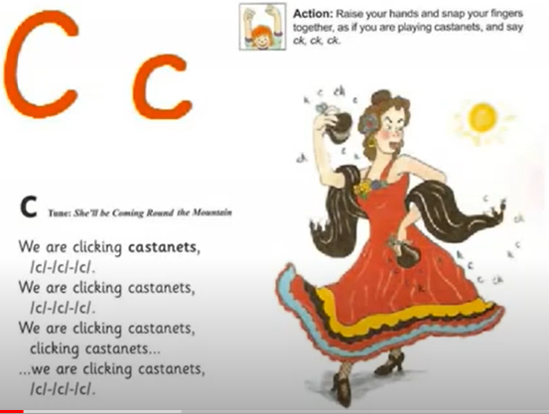

Cc

Slide 3
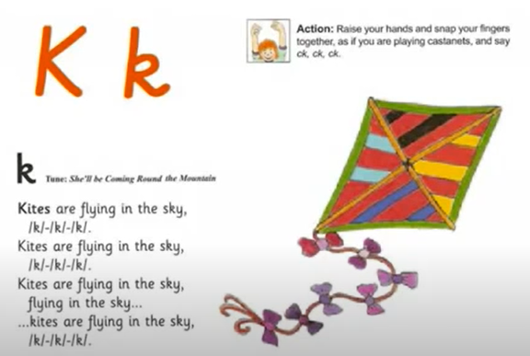
Kk

Slide 4
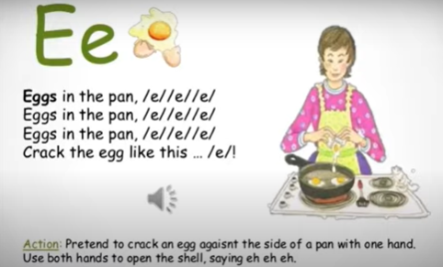
Ee

Slide 5

Rr

Slide 6
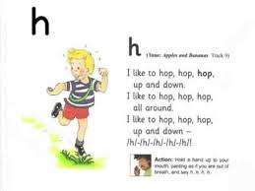
Hh

Slide 7
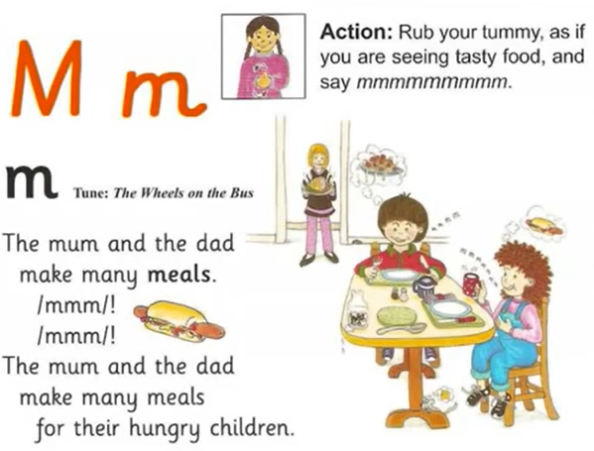
Mm

Slide 8
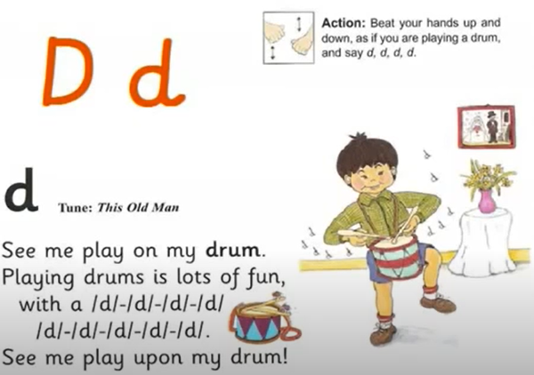
Dd

