Slide 1
A presentation to demonstrate how the sounds are introduced to the children during phonics sessions: g, u, l, o, f, b
Remember: To use the pure sounds (e.g. r = mmmmm, not ruh). Please click on the audio button on each page to hear the correct pronunciation of each sound.
We use a multi-sensory approach when introducing each sound:
Saying the pure sound
Hearing it in words
Finding it in words
Looking at different representations of the letter (As both a capital and lower case letter)
Jolly Phonics Songs can be found here: Jolly Songs Group 3 "g" "u" "l" "o" "f" "b" with actions and letter formation - YouTube
And remember…no ‘schwa’ing! The little learners youtube video explains this really well and can be found here: https://www.youtube.com/watch?v=yVyry9jpVjI

Slide 2
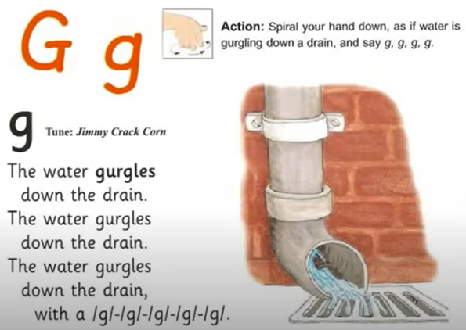

Gg

Slide 3

Uu

Slide 4
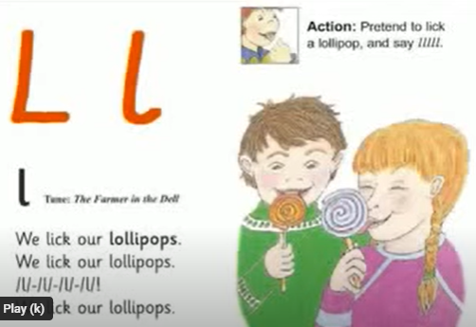
Ll

Slide 5
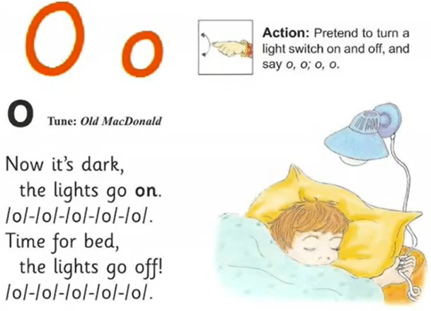
Oo

Slide 6

Ff

Slide 7
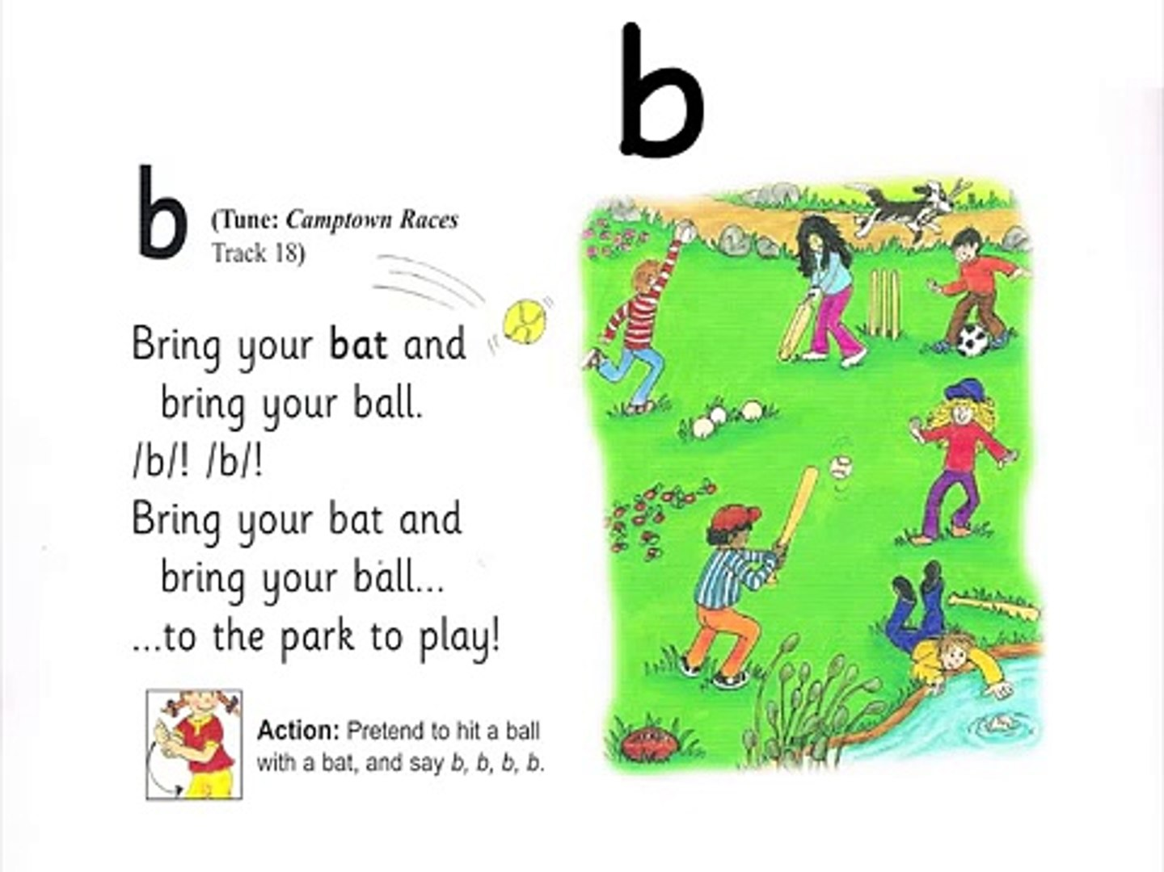
Bb

