Slide 1
Introducing Phonics using ‘Pure sounds’
When introducing the children to a new letter, we talk about the name of the letter and the sound that it makes.
We practise saying the ‘pure sound’, hearing it, and then finding it in words.
We also use the Jolly Phonics songs and actions to reinforce learning.
The songs for the first 6 sounds can be found here:
https://www.youtube.com/watch?v=EM6DHHLG5ao

Slide 2

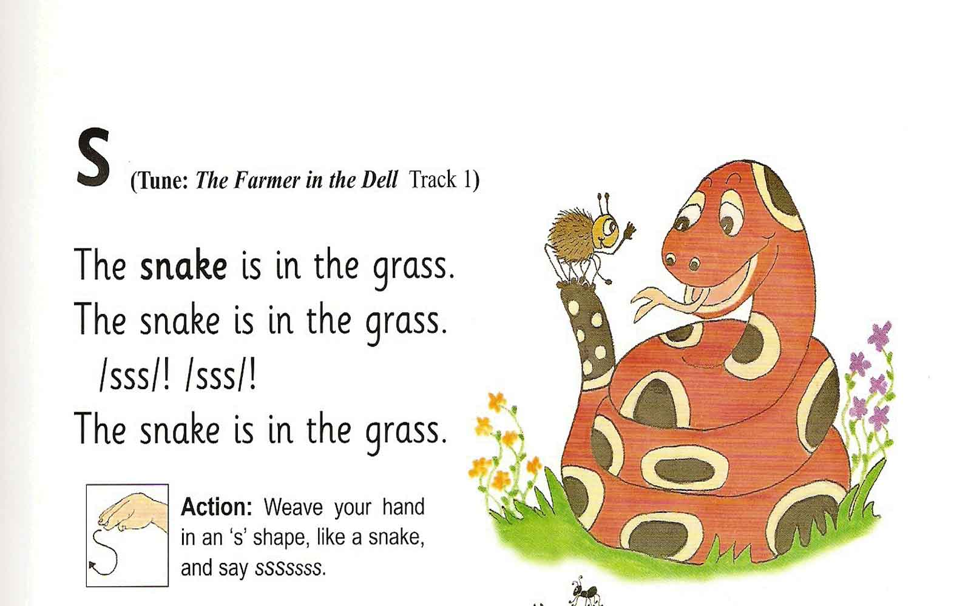

Slide 3


Slide 4
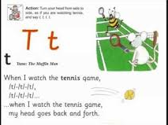

Slide 5
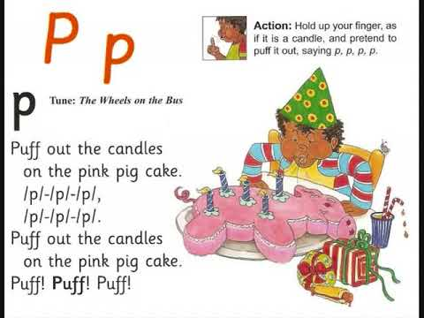

Slide 6
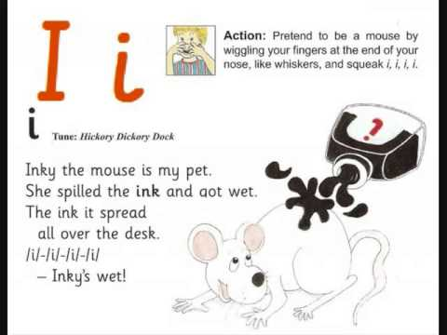

Slide 7


