Slide 1
A presentation to demonstrate how the sounds are introduced to the children during phonics sessions
Remember:
To use the pure sounds (e.g. M = mmmmm, not muh)
We use a multi-sensory approach when introducing each sound:
Singing the Jolly Phonics song
‘Writing’ in the air with our fingers using the handwriting rhymes
Looking at different representations of the letter (As both a capital and lower case letter) ‘My name is M and my sound is mmmm’
Jolly Phonics Songs can be found here: https://www.youtube.com/watch?v=2Am4DtPeMec&list=PLweensYQMHQ1DVeI2BOeZ8KoJyuY_INhH&index=1 (Starting with ‘a’, the sounds are listed in order along the right-hand side of the page – please work through them to demonstrate the sounds introduced each week)

Slide 2

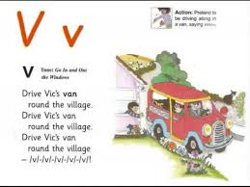
Vv

Slide 3

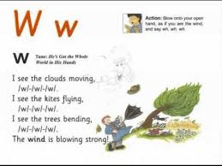

Slide 4
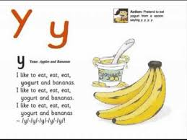
Yy

Slide 5

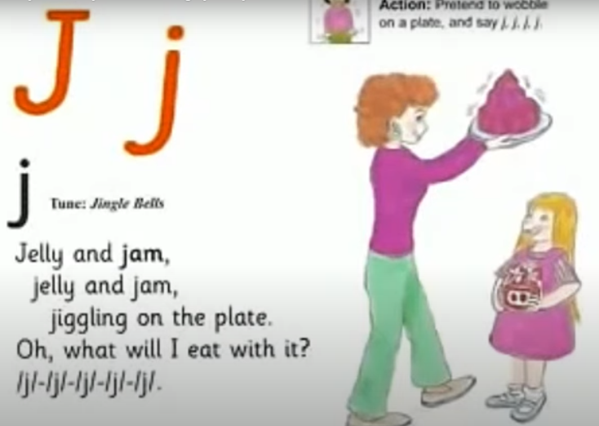

Slide 6
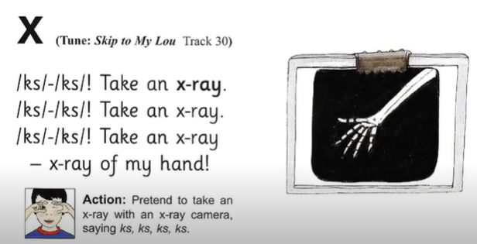
Xx

Slide 7

Zz

Slide 8
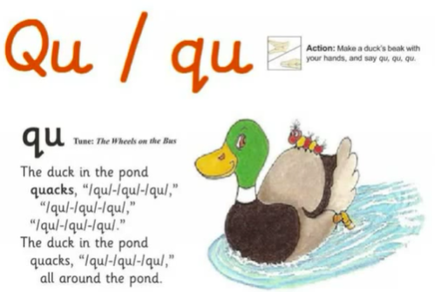
Qq

